Slide 1

Predicting the Occurrence of Strokes from Clinical Data
Amanda Benjamin
Date: 5/3/2022
Project 2 (Part 3)

Slide 2
Background
Stroke: disease of the arteries leading to or within the brain (1)
Occurs when blood vessel is either blocked (ischemic stroke) or bursts (hemorrhagic stroke) → oxygen loss → brain cell death (1)
Function loss
80% of people survive a stroke (4)
Symptoms: sudden numbness (esp. on one side of the body), difficulty talking or comprehending speech, loss of sight, loss of coordination (2)
Mortality rates among adults 35 – 64 years has increased
14.7/100,000 → 15.4/100,000 (3)
Americans spend an annual average of $45.5 billion on direct and indirect costs of stroke (5)

Slide 3
Stroke Prediction Dataset
Feature | Patient 1 | Patient 5110
ID | 1 | 5110
Gender | Male | Female
Age | 67 | 37
Hypertension | 0 | 0
Heart Disease | 1 | 0
Marital Status | Yes | No
Work | Private | Private
Residence | Urban | Rural
Ave. Glucose | 228.69 | 91.72
BMI | 36.6 | 29.2
Smoking Status | Former | Never
Stroke | 1 | 0
Found at: https://www.kaggle.com/datasets/fedesoriano/stroke-prediction-dataset
Provides 11 clinical features for 5110 patients

Slide 4
Stroke Prediction Dataset
Feature | Patient 1 | Patient 5110
ID | 1 | 5110
Gender | Male | Female
Age | 67 | 37
Hypertension | 0 | 0
Heart Disease | 1 | 0
Marital Status | Yes | No
Work | Private | Private
Residence | Urban | Rural
Ave. Glucose | 228.69 | 91.72
BMI | 36.6 | 29.2
Smoking Status | Former | Never
Stroke | 1 | 0
Numerical Variables:
Age: 8 month – 82 yr.
Ave. Glucose: 55.1 – 271.74
BMI: 10.3 – 97.6

Slide 5
Stroke Prediction Dataset
Feature | Patient 1 | Patient 5110
ID | 1 | 5110
Gender | Male | Female
Age | 67 | 37
Hypertension | 0 | 0
Heart Disease | 1 | 0
Marital Status | Yes | No
Work | Private | Private
Residence | Urban | Rural
Ave. Glucose | 228.69 | 91.72
BMI | 36.6 | 29.2
Smoking Status | Former | Never
Stroke | 1 | 0
Categorical Data:
Gender: Male, Female, Other
Hypertension, Heart Disease, Stroke: 0,1
Marital Status: Yes, No
Residence: Urban, Rural
Smoking Status: Never, Former, Smoker

Slide 6
Cleaning Steps
Deleted Unnecessary Columns
Patient ID #
Checked for Duplicate Rows
df.duplicated().sum()
Identify and addressed missing values
Dropped Missing Data
Checked for Inconsistencies in Categorical Values
None
~4%

Slide 7
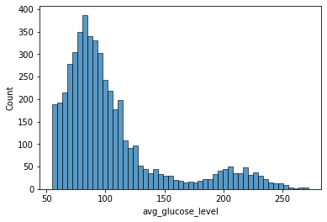
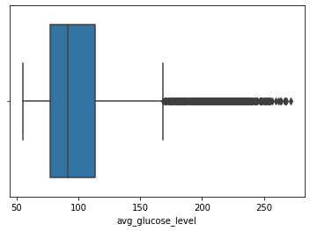
Average Glucose Level

Slide 8
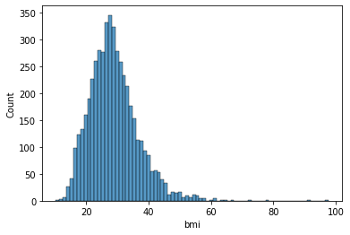
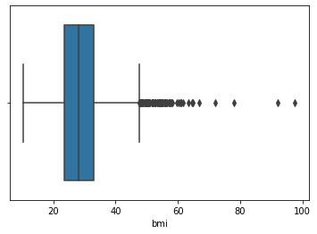
BMI

Slide 9
Works Cited
(1): https://www.stroke.org/en/about-stroke#:~:text=Stroke%20is%20a%20disease%20that,or%20bursts%20(or%20ruptures).
(2): https://www.cdc.gov/stroke/signs_symptoms.htm
(3): https://www.ahajournals.org/doi/10.1161/CIR.0000000000000950
(4): https://www.ucihealth.org/blog/2019/05/life-after-stroke
(5): American Heart Association, Heart Disease and Stroke Statistics—2019 Update, 2019, p. e517.

